Slide 1
ANOVA——Able-bodied data(two)

Slide 2
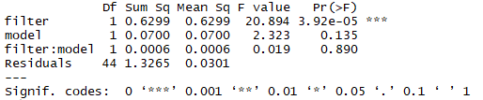
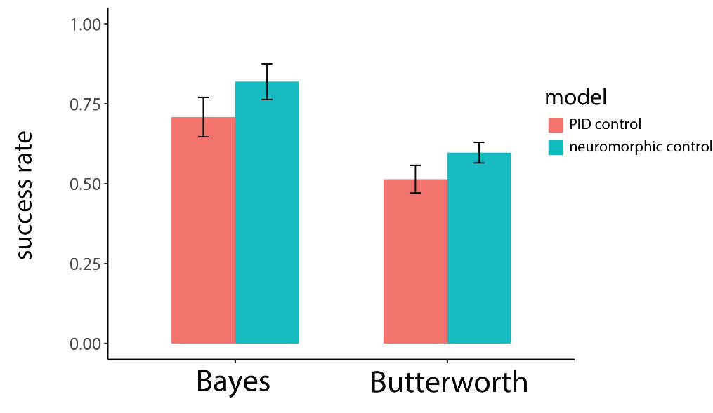
Success rate——able-bodied subject
filter— F(1,44)=20.894, P<0.001
model—F(1,44)=2.323, P=0.135
filter: model —F(1,44)=0.019, P=0.890

Slide 3
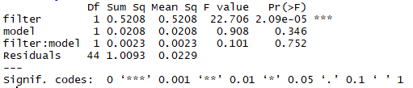
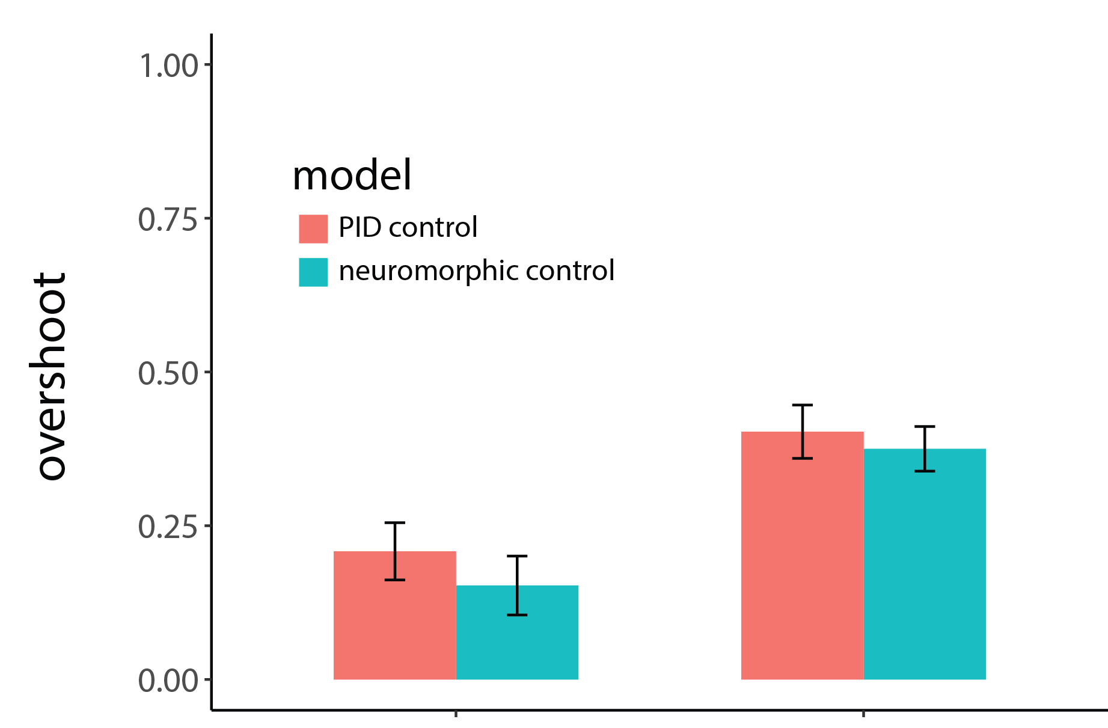
Break rate ——able-bodied subject
filter—F(1,44)=22.706, P<0.001
model—F(1,44)=0.908, P=0.344
filter: model —F(1,44)=0.101, P=0.752
Bayes Butterworth

Slide 4

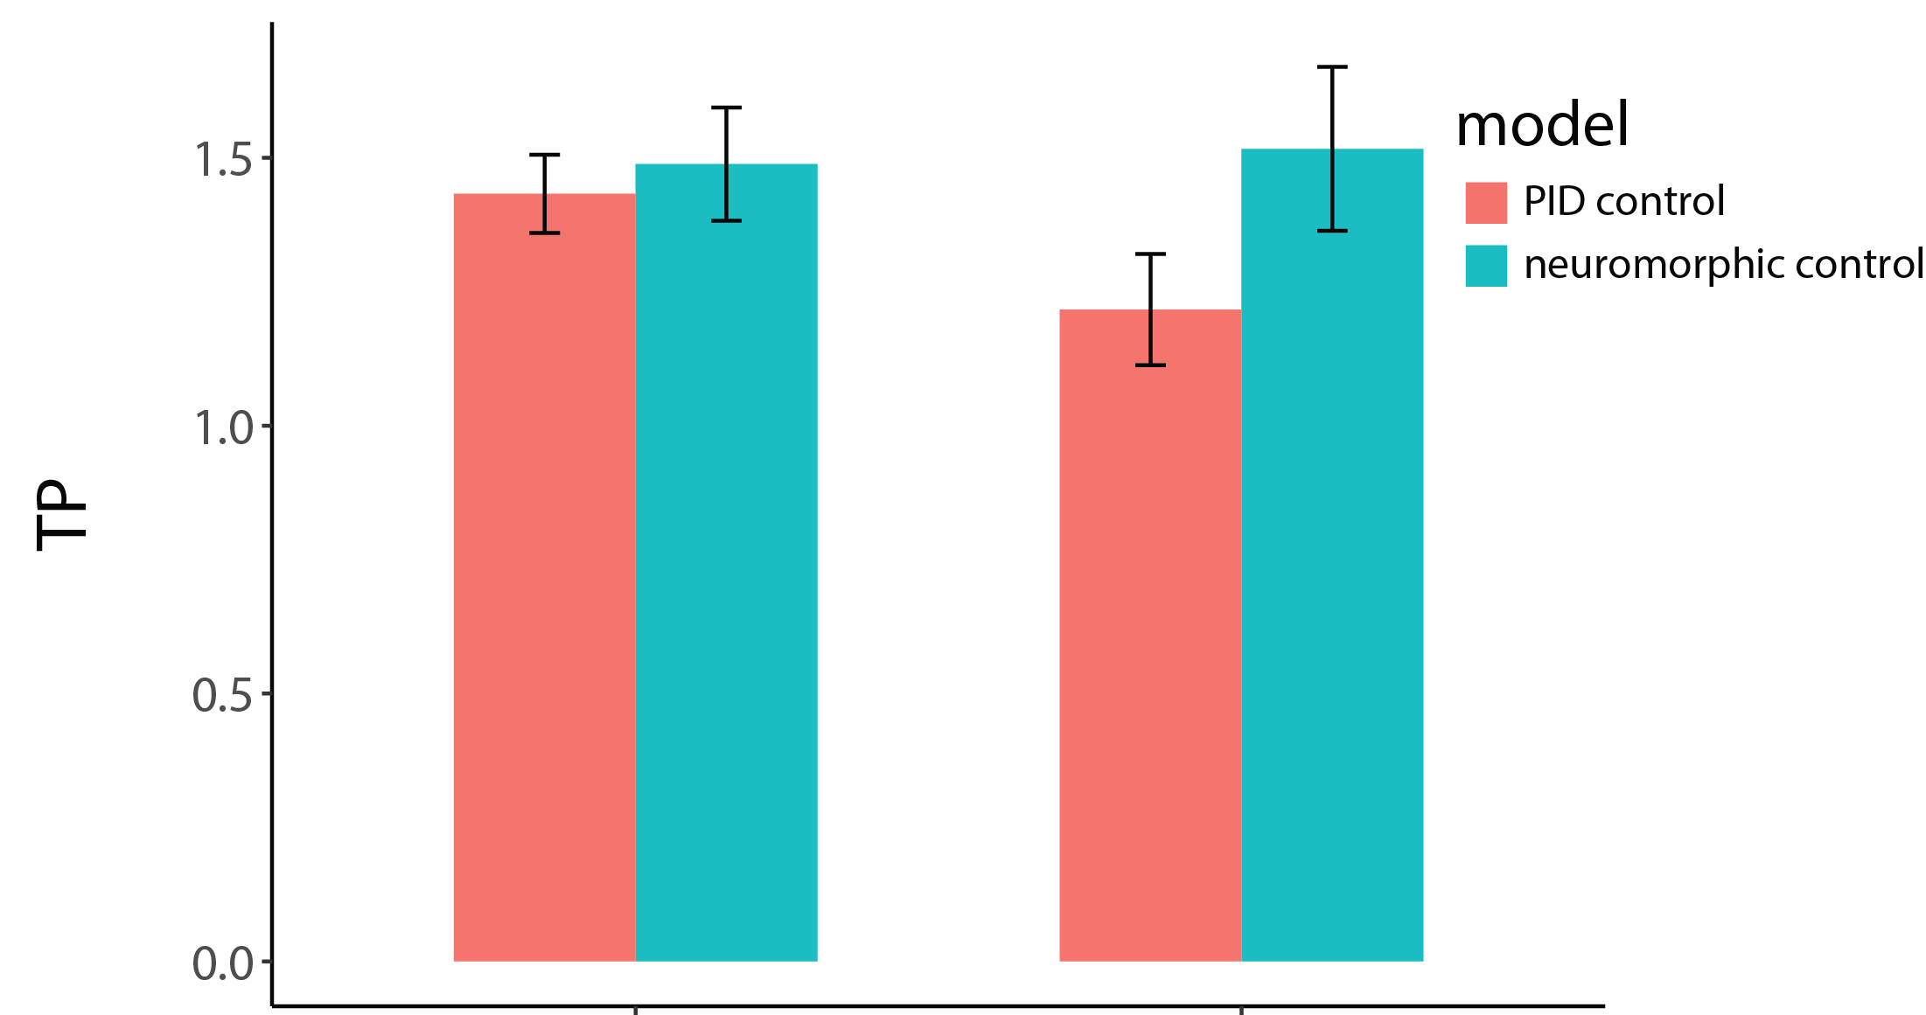
Throughput ——able-bodied subject
filter: F(1,44)=0.695, P=0.409
model: F(1,44)=2.490, P=0.122
filter: model —F(1,44)=1.178, P=0.284
Bayes Butterworth

